Slide 1

FedFast: Going Beyond Average for Faster Training of Federated Recommender Systems
Khalil Muhammad , Qinqin Wang
Insight Centre for Data Analytics, University College Dublin, Dublin, Ireland
†Samsung Electronics Co., Ltd., Seoul, Republic of Korea
SIGKDD, 2020
Reporter: Tang Qidong, 2020.09/23
Notes:
author韩国的一篇文章，发表于KDD2020

Slide 2
Outline
Preliminary
Motivation and Contribution
Algorithm
Experiments and Thinking
Notes:
My presentation will expand from the following four parts.
Introduce in order

Slide 3
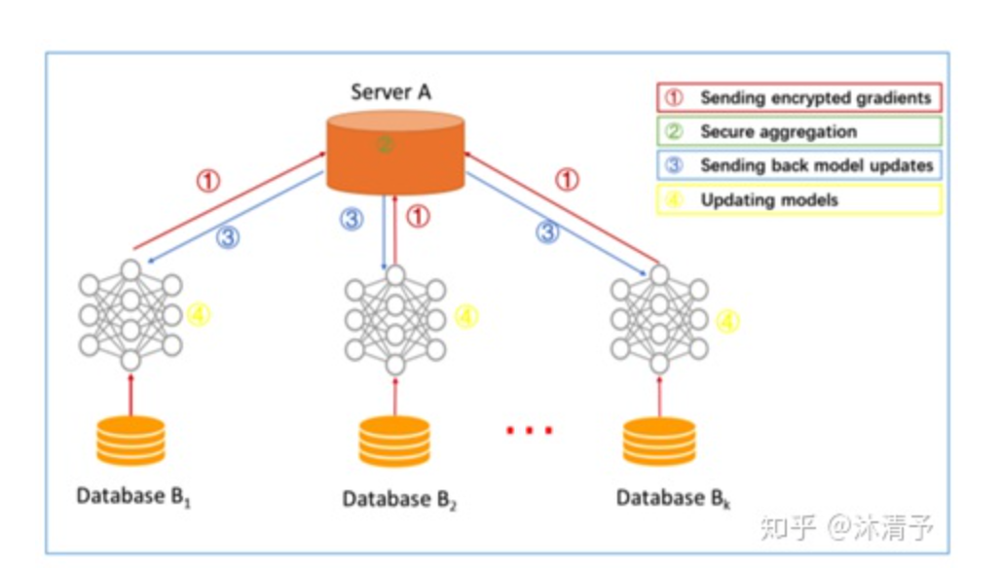
Preliminary – Federated Learning
Federated Learning leaves the training data distributed on the mobile devices, and learns a shared model by aggregating locally-computed updates.
Notes:
For traditional RS models,main characteristic is that they are centralised, not scalable as the number of users and items increase, and require users to share their personal data with the server；
To improve scalability and overcome the need for central collection of data,
Horizontal federated Learning, Concluded into 4 steps: sketch map
each participant is a client, all clients download the latest model from server, named A here;
each client uses local data to train the model and uploads the gradient to server A. The gradient can also be encrypted. After received, The server A aggregates the gradient of each user to update the model parameters;
server A returns the updated model to each client;
Each client updates their own model.

Slide 4
Characteristics of Federated Learning
Training on real-world data from mobile devices provides a distinct advantage over training on proxy data that is generally available in the data center.
This data is privacy sensitive or large in size (compared to the size of the model), so it is preferable not to log it to the data center.
For supervised tasks, labels on the data can be inferred naturally from user interactionß
Notes:
Proxy data 代理数据
(2) Not cost-effective, In contrast, the information transmitted for federated learning is the minimal update necessary to improve a particular model. No need to load the original data, safer.
(3)Example: image classification: predicting which photos are most likely to be shared
language models: used to improve voice recognition and text entry on touch-screen keyboards.

Slide 5
Properties of FL compared to distributed optimization
Non-IID (None Independent Identically Distributed)
Unbalanced
Massively distributed
Limited communication
Notes:
1.The training data on a given client is typically based on the usage of the mobile device by a particular user, and hence any particular user’s local dataset will not be representative of the population distribution.
2.some users will make much heavier use of the service or app than others, leading to varying amounts of local training data.
3.The number of clients participating in an optimization is much larger than the average number of examples per client.
4.Limited communication Mobile devices are frequently offline or on slow or expensive connection

Slide 6
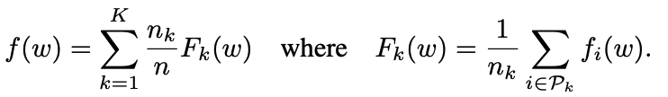




Baseline -- FedSGD
Too many communications !!!
Increase computation on each client.
Rather than performing a simple computation like a gradient calculation, each client performs a more complex calculation between each communication round.
Notes:
The loss function can be written as equation 1. For each client, its local data is denoted as P_k. and nk is the number of clients. n is the total number of data, including all the n clients.
For equation 2, gk is the average gradient on its local data from client k.
Equation 3 defines how to update the parameter in the server. The server takes a weighted average of the resulting models. The coefficient of weighted average is according to the amount of data for each client.
Each round of update, A fraction of clients are randomly selected with the ratio as C;
Then, the server sends the current global (algorithm) status to these clients (for example, the current model parameters) ;
Each client performs local calculations based on the global state and its local data set, and sends updates to the server

Slide 7
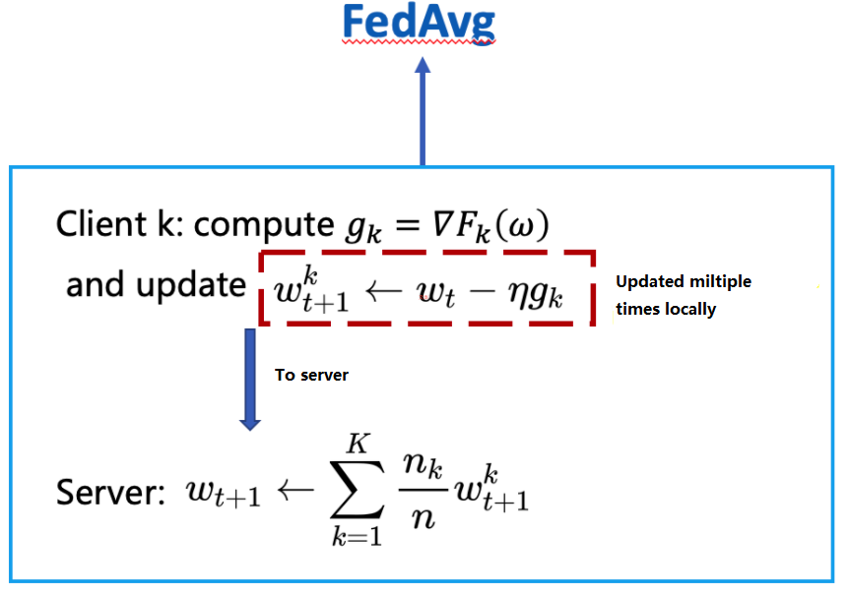
FedAvg (Federated Averaging)
Notes:
Difference : each round, the parameter is updated multiple times locally.
In this way, more computation is assigned to each client between 2 communications.
As a result, the time to communicate is saved.
5g

Slide 8
Motivations
In FL systems, users tend to incur the majority of the costs involved in training the model. Specifically, there is a potential for users to experience performance degradation and an increase in communication payload during the training process. These issues can easily frustrate users and ultimately reduce the acceptance of the recommender system, especially if they have to wait for a long time to enjoy good quality, personalised recommendations.
Notes:
1.Majority of the costs to train
2.Performance degradation and increased communication payload during the training process. Especially at the early stage of training, the performance is usually bad which may frustrate users.

Slide 9
Contributions
FedFast, speeds up the convergence rate of recommendation models while guaranteeing that users benefit from more accurate recommendations even before the training process is complete.
ActvSAMP, to better choose the users that participate in each round of training;
ActvAGG, to combine locally trained models in a smart manner that speeds up the training process.
Notes:
1.Propose a method to speed up the convergence rate of recommendation.
2 aspects: 1.serves to better choose
2.is used to combine

Slide 10
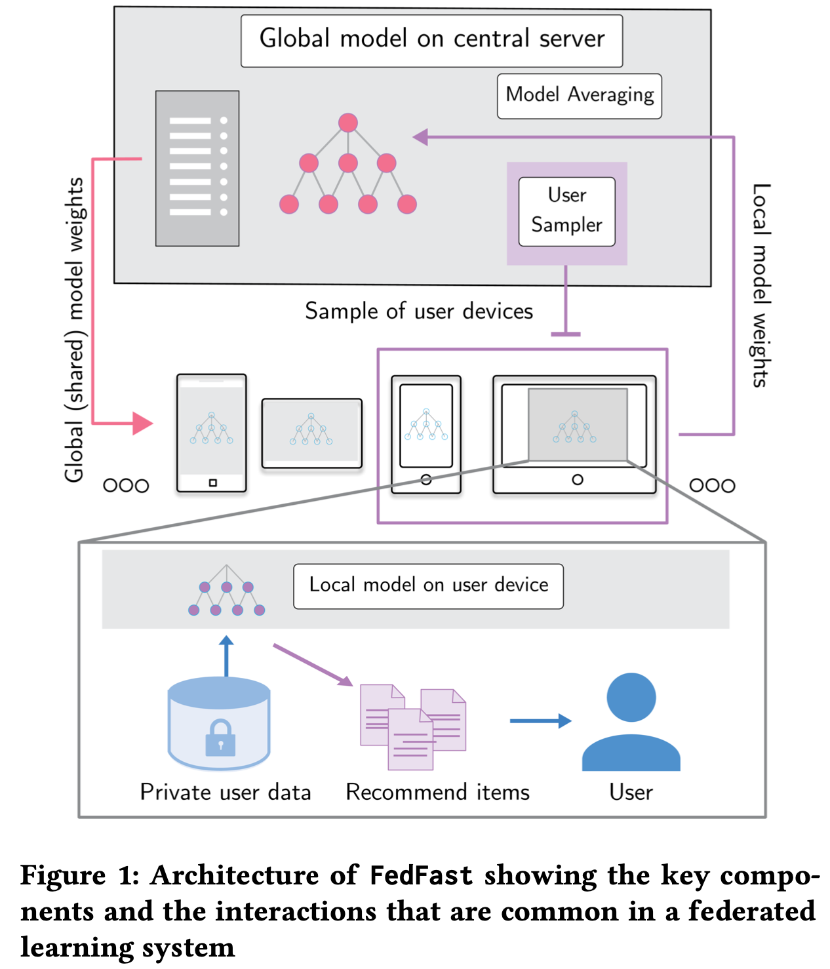
Federated Architecture
ActvSAMP
to better choose the users that participate in each round of training;
ActvAGG
to combine locally trained models in a smart manner that speeds up the training process.

Slide 11
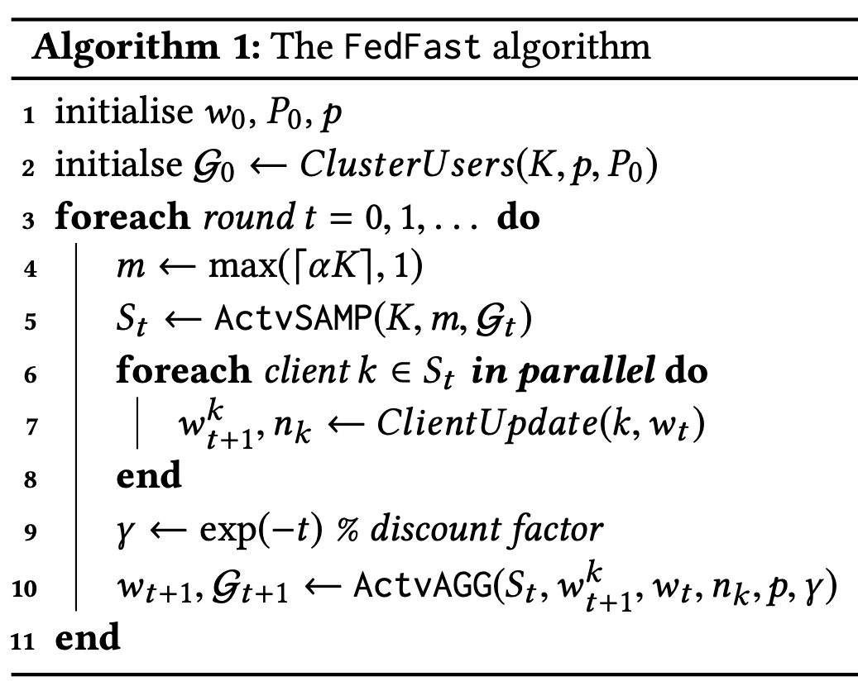
Federated Architecture
Notes:
The picture on the left shows the overall architecture, the algorithm on the right shows the calculation process.
The special point has been stated above,
The clients involved are not selected randomly, it is chosen carefully by ActvSAMP
In the conventional FL, the parameter of clients are updated once they are chosen in this round. However in this paper, the clients that are not selected can also be updated by its neighboring clients, by ActvAGG.
Next, I will introduce ActvSAMP and ActvAGG in detail.

Slide 12
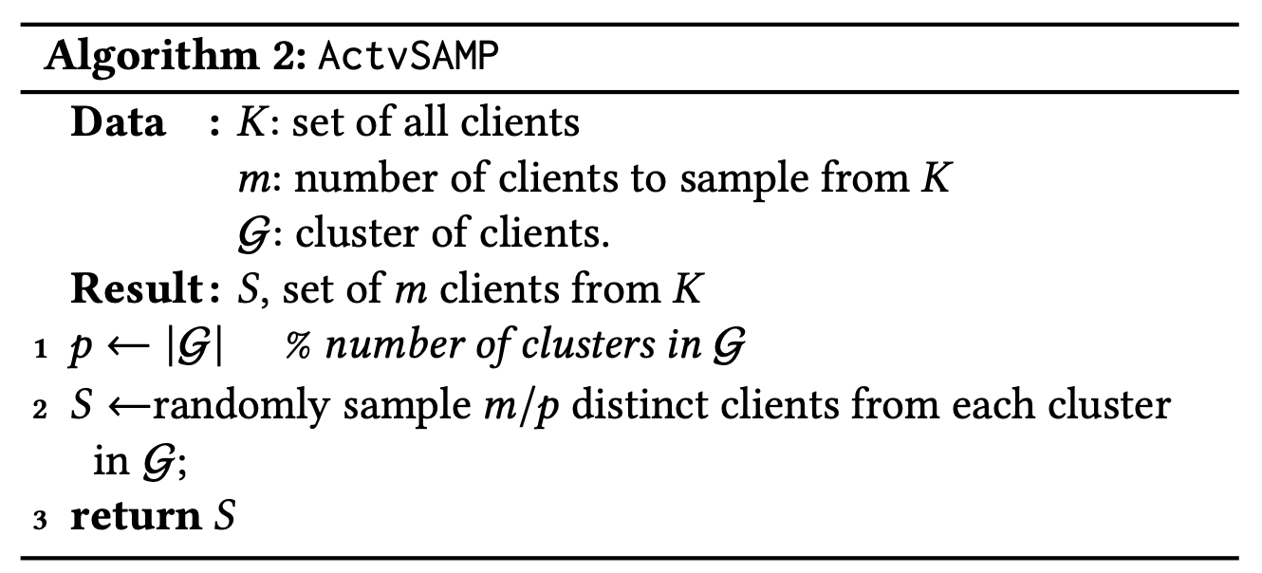
Details -- ActvSAMP
Notes:
“Clients in a typical RS tend to be heterogeneous with users having diverse preferences about different items. ”
When users are grouped based on their profile similarities, then each group can benefit from the training experience of their peers that participate in training the RS model. This within-group exchange of training experiences should reduce client workloads, reduce communication rounds to the server, improve recommendation quality, and increase the convergence speed of the model
In Alg, The clients are grouped to G clusters. This ActvSAMP randomly samples one client per cluster in G in a round-robin manner until there are m clients in the sampling set St . That is to say, the number of clients from different clusters are basically the same.

Slide 13
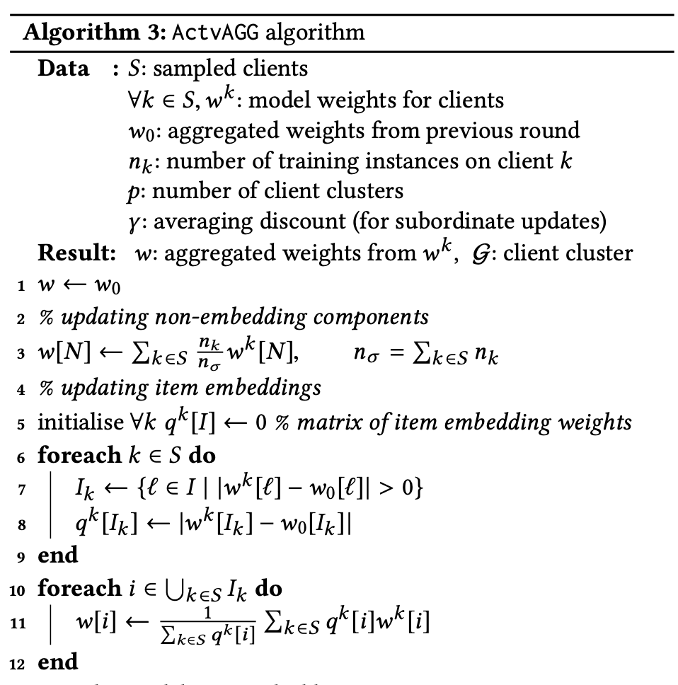
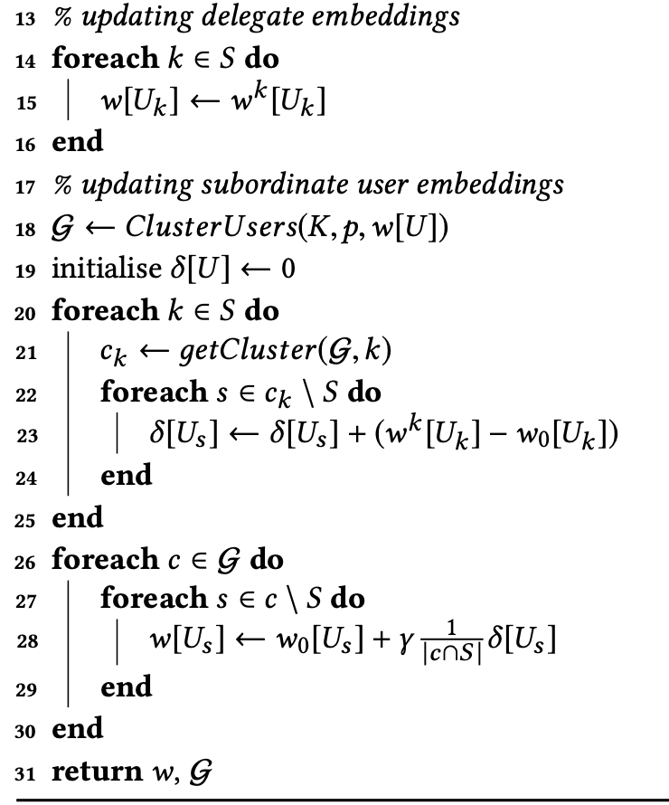
Notes:
1. Updating the non-embedding components, as FedAvg(do not correspond to user or item Embeddin)

Slide 14
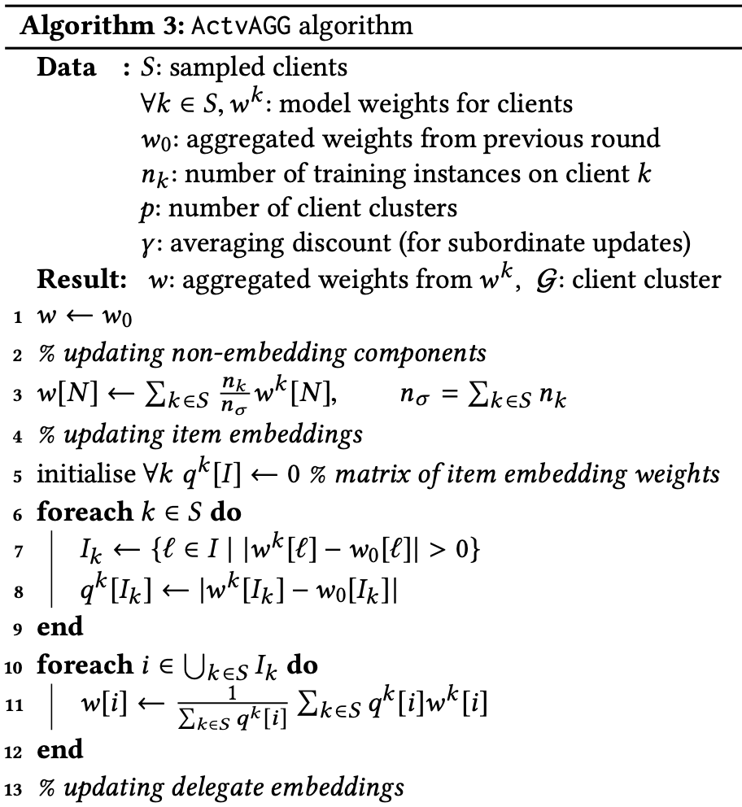
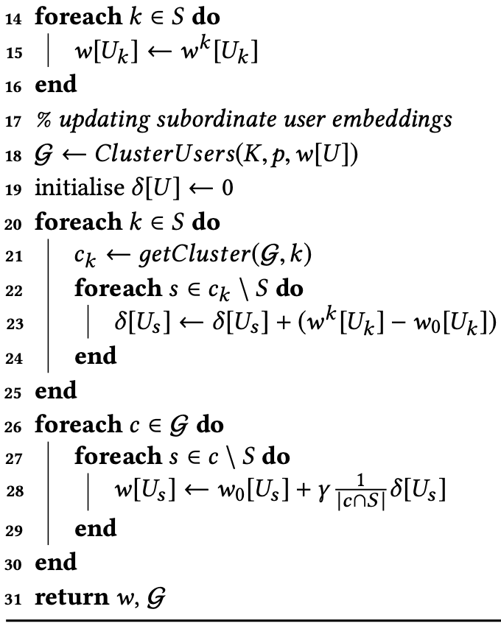
Notes:
those clients that partake in model training on a particular round are refered as delegates; and those that do not participate in the training process as subordinate
1. Updating the non-embedding components, as FedAvg(do not correspond to user or item Embeddin)
2. Item-Embed: qk:the difference between () and the aggregated value from the previous round, w0. The I-Embed is formed as a weighted average of the parameter values wk [i] learned by each delegate, where each delegate’s contribution is proportional to qk;
这里的user-Embedding 其实相当于查表？？每人一列？ 4. re-partition: A new client partition, G, is formed, using the newly obtained user embeddings 5. Each subordinate is updated using the user embeddings of all delegates that share its cluster. The difference of all delegates in a cluster is accumulated, and the averaged differences are used to update the parameter of the subordinate in the same cluster, with a discount factor.
两个问题，一是加权更新的权值，另一个是为什么先聚类再给broadcast to subordinate

Slide 15
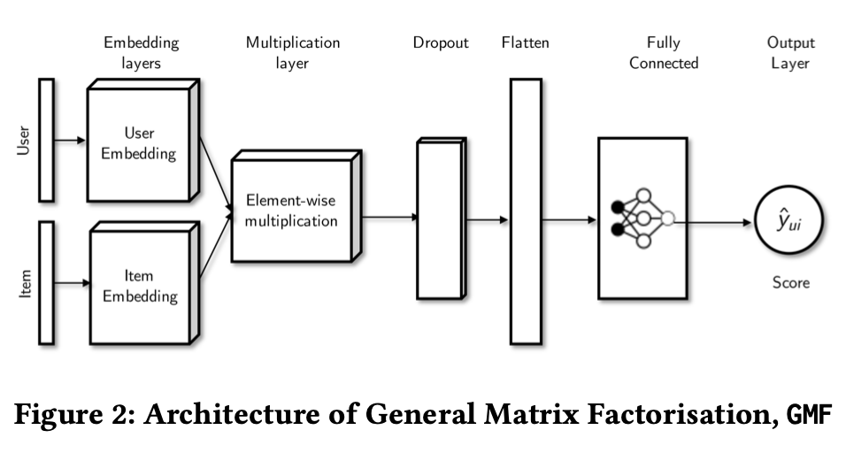
GMF Architecture
Notes:
This is the architecture of a recommendation model, named GMF (Generalized Matrix Factorization)
U,I→embeddings
Element-wise multiplication is applied to
Fully collected layers is used for finally scoring
entire model,

Slide 16
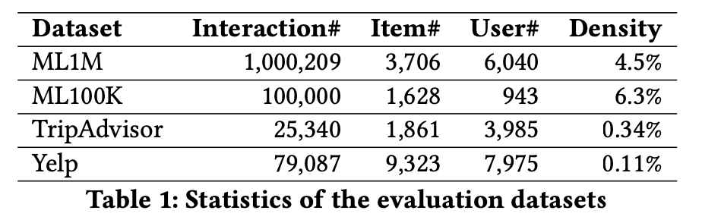
DataSet
The evaluation criterion is HR(Hit Ratio) and NDCG(Normalized Discounted Cumulative Gain)
Notes:
4 datasets, Relatively small datasets. Density??
Hit Ratio:分母(denominator)是所有的测试集合，分子(numerator)是每个用户前K个中属于测试集合的个数的总和，该指标衡量是召回率，该指标越大越好
NDCG:考虑到位置的影响，越前面的影响越大

Slide 17
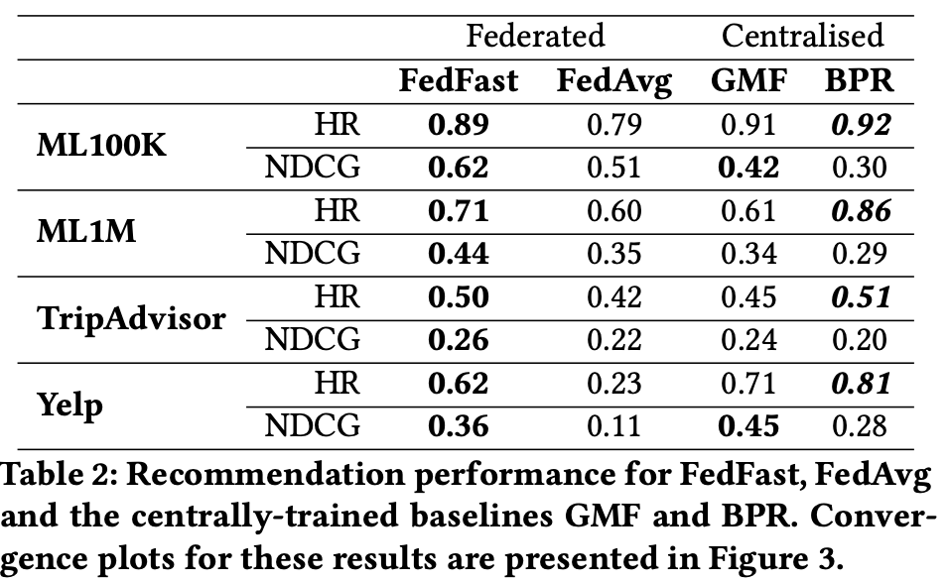
Experiment – Performance Comparison
Notes:
Always better than FedAvg
Comparable to GMF and BPR, sometimes better than them

Slide 18
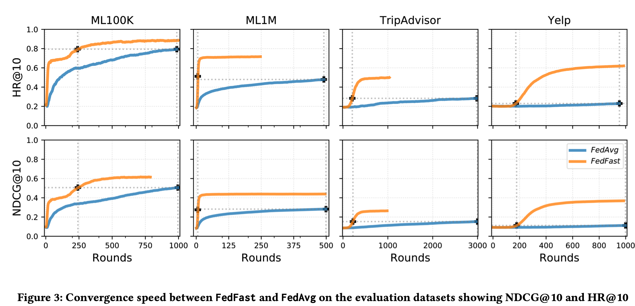
Experiment – Convergence Analysis
Notes:
Converges at early rounds, accuracy is better.
Problem: x-axis is indexed by rounds, not time!!!! Communication load is less, not sure for time

Slide 19
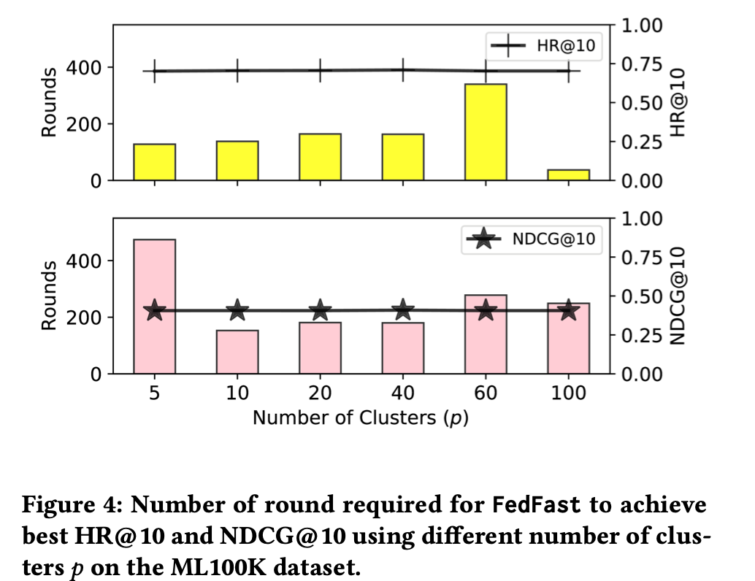
Experiment – Sensitivity of #(clusters)
Notes:
To explore the best number of p

Slide 20
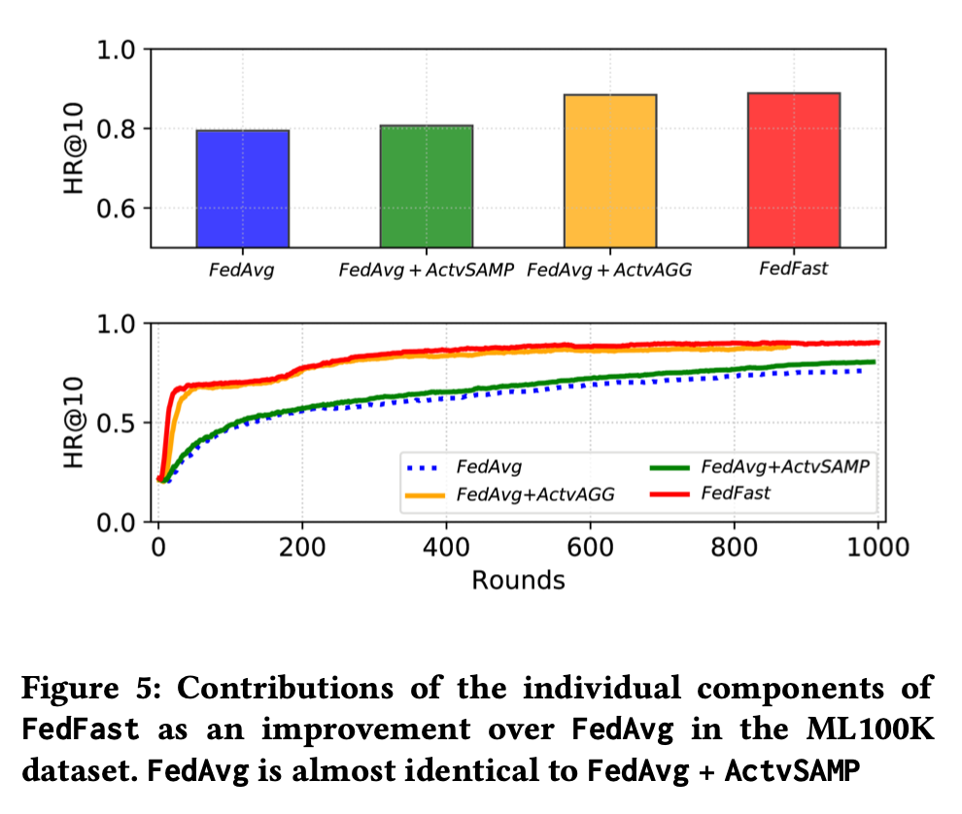
Experiment – sensitivity Analysis
Notes:
Which part is useful. And the contributions of each part?

Slide 21
Thinking
Actually use neighboring users’ information for updating? Is it will be better to get update from server each time.
The formation is similar to Meta-learning(MAML, Reptile). Small tasks(Meta-training, Meta-test)
Locally train → Privacy safety
Notes:
quanlity profile.

